Slide 1
Files and Streams, Exception Handling in C++ Md. Alamgir Hossain Senior Lecturer, Dept. of CSE Prime University Mail: alamgir.cse14.just@gmail.com

Slide 2
Files and Streams
In C++ programming we are using the iostream standard library, it provides cin and cout methods for reading from input and writing to output respectively.
To read and write from a file we are using the standard C++ library called fstream. Let us see the data types define in fstream library is:
fstream | It is used to create files, write information to files, and read information from files.
ifstream | It is used to read information from files.
ofstream | It is used to create files and write information to the files.

Slide 3
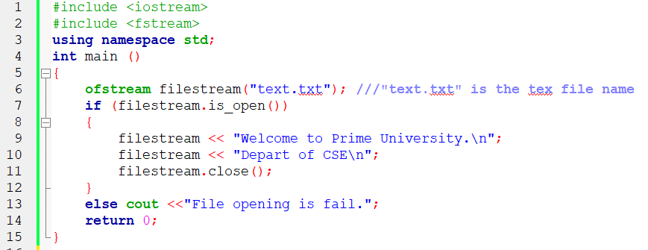
File Stream Example: Writing to a File

Slide 4
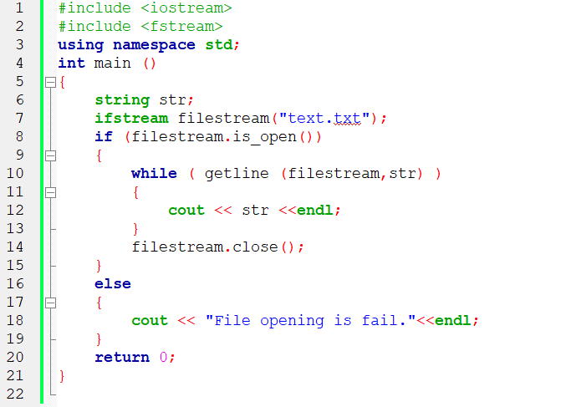
File Stream Example: Reading from a File

Slide 5
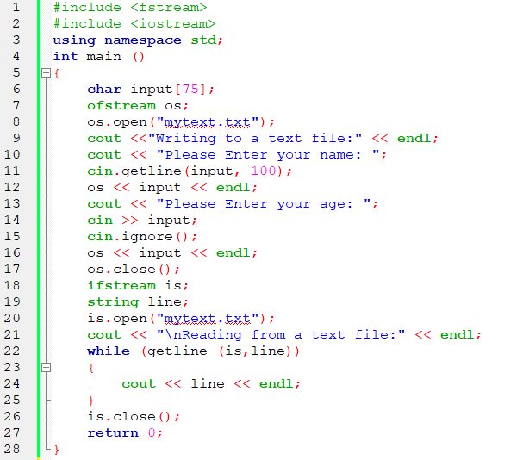
C++ Read and Write Example

Slide 6
Exception Handling
One of the advantages of C++ over C is Exception Handling. Exceptions are run-time anomalies or abnormal conditions that a program encounters during its execution.
There are two types of exceptions: a) Synchronous, b) Asynchronous(Ex:which are beyond the program’s control, Disc failure etc).
The term synchronous exception means that exceptions can be originated only from throw expressions.
C++ provides following specialized keywords for this purpose.
try: represents a block of code that can throw an exception.
catch: represents a block of code that is executed when a particular exception is thrown.
throw: Used to throw an exception. Also used to list the exceptions that a function throws, but doesn’t handle itself.

Slide 7
Advantages of Exception Handling
Separation of Error Handling code from Normal Code: In traditional error handling codes, there are always if else conditions to handle errors. These conditions and the code to handle errors get mixed up with the normal flow. This makes the code less readable and maintainable. With try catch blocks, the code for error handling becomes separate from the normal flow.
Functions/Methods can handle any exceptions they choose: A function can throw many exceptions, but may choose to handle some of them. The other exceptions which are thrown, but not caught can be handled by caller. If the caller chooses not to catch them, then the exceptions are handled by caller of the caller. In C++, a function can specify the exceptions that it throws using the throw keyword. The caller of this function must handle the exception in some way (either by specifying it again or catching it)
Grouping of Error Types: In C++, both basic types and objects can be thrown as exception. We can create a hierarchy of exception objects, group exceptions in namespaces or classes, categorize them according to types.

Slide 8
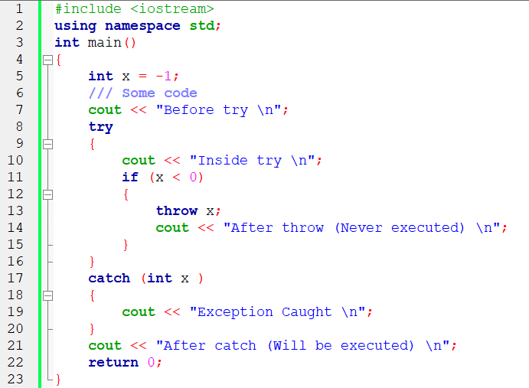
Exception Handling in C++
Following is a simple example to show exception handling in C++. The output of program explains flow of execution of try/catch blocks.

Slide 9
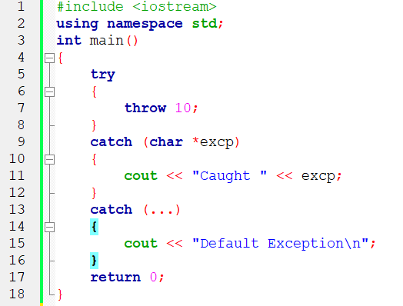
Exception Handling in C++
There is a special catch block called ‘catch all’ catch(…) that can be used to catch all types of exceptions. For example, in the following program, an int is thrown as an exception, but there is no catch block for int, so catch(…) block will be executed.

Slide 10
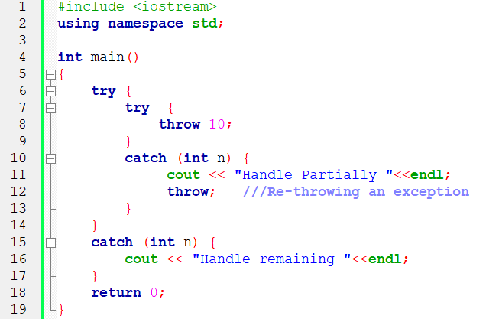
Exception Handling in C++
In C++, try-catch blocks can be nested. Also, an exception can be re-thrown using “throw; ”

Slide 11
Handling the Divided by Zero Exception in C++
We use Exception Handling to overcome exceptions occurred in execution of a program in a systematic manner.
Dividing a number by Zero is a mathematical error (not defined) and we can use exception handling to gracefully overcome such operations.
If we write a code without using exception handling then the output of division by zero will be shown as infinity which cannot be further processed.

Slide 12
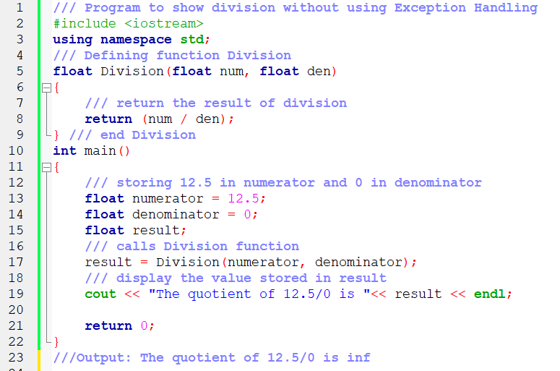
Handling the Divided by Zero Exception in C++

Slide 13
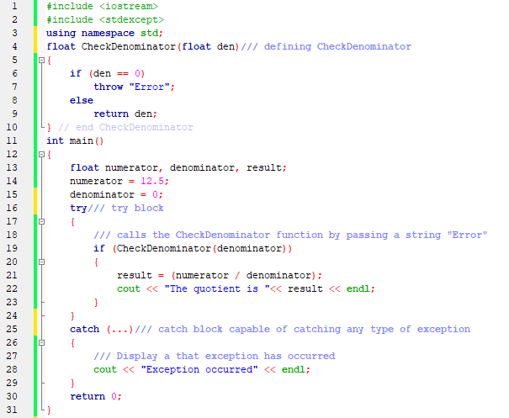
Handling the Divided by Zero Exception in C++

Slide 14
Thank You

